Slide 1


Giving a 1-minute Elevator Pitch
DO NOT RESIZE – if this shape is not suitable for your image you must delete it and add an image manually.
COMP1100/7110
Materials by Stuart Crosbie, UQ

Slide 2

Discussion
Share your thoughts:
How do you feel about delivering an Elevator Pitch?
What should we consider when delivering an Elevator Pitch?
Notes:
3 min.

Slide 3
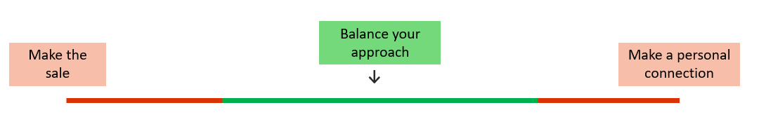
What is an elevator pitch?
An elevator pitch is an opportunity to:
→ share a quick summary of yourself and your product offerings.
→ make a real connection that can create long-term benefits.
NOTE: These two goals are quite different, so ensure you find a good balance.
Notes:
2 min/5

Slide 4

How do you perform an effective elevator pitch?
Below are the stages of an effective elevator pitch.
What order should the stages be in?
Present your solution
Add a call to action
Share your value proposition
Introduce yourself
Present the problem
3
5
4
1
2
Notes:
1 minute to discuss the stage. Be strict with timing. 3 min/8

Slide 5
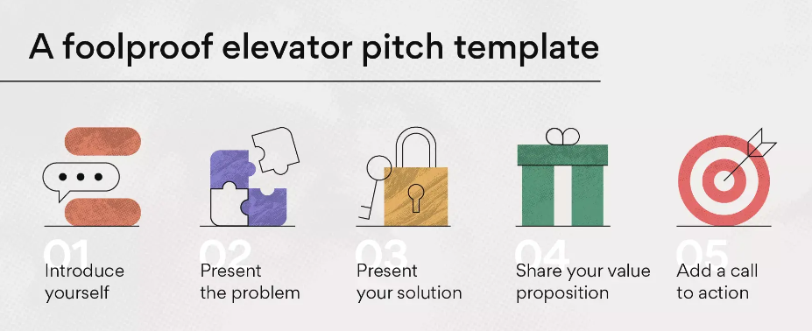
Elevator Pitch - Stages
Notes:
Reinforces the answers from previous. Show & go.1 min/9

Slide 6


Stage 1 – Introduce yourself
What to do
Give your name.
Introduce your organisation.
Use a hook to capture attention.
What is a hook?
→ A hook gets the audience interested in you and/or what you are saying.
How do you do that?
There are different approaches, but the most common ones are:
telling a story.
showing an image.
sharing a fact.
sharing a statistic.
Write it out and show it to your legend as they walk around.
Notes:
6 min/15

Slide 7
Stage 2 – Present the problem
What to do
Describe a problem that your business is trying to solve.
Make the problem clear and relevant to your audience e.g. by using a real-world example, or a visual.
Be brief.
ONE METHOD: Connect your problem to your hook
HOOK – Did you know that sixty percent of
workers’ time is spent on work coordination
as opposed to actually doing the work?
PROBLEM - And that might be the reason
why many in your industry are struggling
with productivity issues.
Notes:
2 min/17

Slide 8
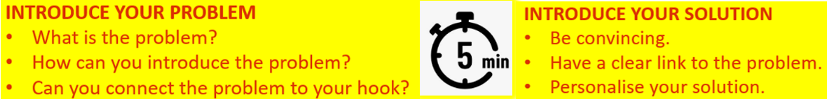
Step 3 – Offer the solution
Did you know that sixty percent of
workers’ time is spent on work coordination as opposed to actually doing the work?
What to do
Convince the audience that they need your help.
Ensure a strong link to the problem you have raised.
Personalise your solution if you can.
And that might be the reason why many in your industry are struggling with productivity issues.
SOLUTION – However, Taskmanager’s
management tools can help you prevent these issues.
Write it out and show it to your legend as they walk around.
Notes:
8 min./25

Slide 9
Step 4 – Explain your Unique Value Proposition (UVP)
What to do
Explain WHY your solution is better than the rest.
Talk about a unique ability/skill that you have.
OR
Make a comparison with a competitor or a service that is currently provided.
What is special about YOU?
Did you know that sixty percent of workers’ time is spent on work coordination as opposed to actually doing the work?
And that might be the reason why many in your industry are struggling with productivity issues.
However, Taskmanager’s management tools can help you prevent these issues.
UVP – In fact, our platform is currently the only one that connects company goals with the tasks needed to achieve them.
Notes:
2 min.

Slide 10

Step 5 – Add a call to action
What next?
Did you know that sixty percent of workers’ time is spent on work coordination as opposed to actually doing the work?
What to do
Think about what you want the audience to do to continue your communication with them.
Ask them to do it. For example, would you like them to:
schedule a follow-up meeting?
connect on LinkedIn?
exchange business cards.
And that might be the reason why many in your industry are struggling with productivity issues.
However, Taskmanager’s management tools can help you prevent these issues.
In fact, our platform is currently the only one that connects company goals with the tasks needed to achieve them.
Call to Action – We find this to be an exciting industry to work in, and we would love to have a follow up meeting in which we could learn more about you and provide specifics about how exactly Taskmanager can help.
Write it out and show it to your legend as they walk around.
Notes:
8 min./ 35

Slide 11
ACTIVITY
https://www.youtube.com/watch?v=-1IdJDscYHk
As a class, watch the movie above
Identify the main parts of a pitch:
Introduction
Present the problem
Offer the solution
Explain the unique value proposition
Call to action
Are each of these present?
Notes:
1 min/ 36

Slide 12


These two people are just about to present.
How do they feel?
One is confident and the other is extremely nervous.
What can YOU do to develop confidence?
PRACTICE !
Notes:
1 min/ 36

Slide 13

Elevator Pitch - Delivery
So how do you practice?
What do you look for if you are listening or watching yourself practice?
Name 5 aspects of delivery that you can evaluate.
Delivery
Voice Projection
Clarity
intonation
pausing
Body language
Notes:
4 min/ 40

Slide 14

TEAM ACTIVITY: What do these words mean?
Delivery
Voice Projection
Clarity
intonation
pausing
Body language
https://wordwall.net/resource/59118091
Let’s check…..
Notes:
5 min/ 45

Slide 15
Delivery
Voice Projection
Clarity
intonation
pausing
Body language
HOW you say it, not WHAT you say
style
voice
personal presentation:
clothes
movement
eye contact
visual aids
Notes:
1 min/ 46

Slide 16

Voice Projection
Clarity
intonation
pausing
Body language
delivery
Be heard
Hold your audience’s attention
Notes:
1 min

Slide 17


clarity
intonation
pausing
Body language
Delivery
Voice Projection
“Did you know that sixty percent of
workers’ time is spent on work coordination?”
Was that clear?
It was? OK, why?
clear and easy to understand
Notes:
1 min. / 47

Slide 18

intonation
pausing
Body language
delivery
Voice Projection
Clarity
↗
“Did you know that sixty percent of
workers’ time is spent on work coordination?”
↗
↘
the rise and fall of your voice
Notes:
2 min. /49

Slide 19

pausing
Body language
delivery
Voice Projection
Clarity
intonation
“Did you know that sixty percent of workers’ time is spent on work coordination?”
/
/
//
little breaks in speaking to help the presenter and the audience
When do I pause?
At punctuation, esp. commas (/) and full stops (//)
Between clauses
After long noun phrases
Before prepositional phrases
Pauses can help but
don’t overdo it!!
Notes:
3 min. / 52

Slide 20
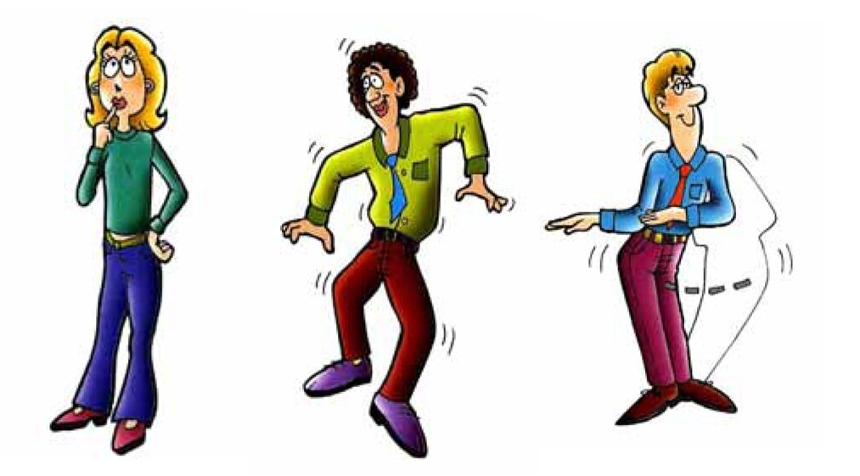

Body language
delivery
Voice Projection
Clarity
intonation
pausing
non-verbal communication:
a combination of movements, gestures and postures
MacMillan Language House
Notes:
1 min. / 53

Slide 21

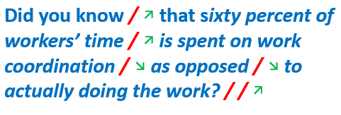
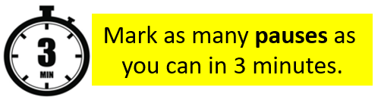
The Elevator Pitch
Now let’s consider where intonation and pauses should go in your script.
Notes:
7 min. / 60

Slide 22

The Elevator Pitch – Practice 1
Everyone stand up
Read your presentation aloud.
Yes, all at the same time
How noisy can you be?
Notes:
3 min. / 63

Slide 23
The Elevator Pitch – Practice 2
Give your pitch again – this time to a partner.
Listen and give feedback
(How people respond to your pitch will indicate the clarity of your ideas)
Feedback: ☺ ☹ Delivery
Voice projection
Clarity
Intonation
Pausing
Body language
Notes:
5 min. /68

Slide 24


Summary of key elements: Content +….
Delivery | Voice Projection | Clarity
Intonation | Pausing | Body Language
Notes:
2 min / 70

Slide 25
EXIT TICKET
REMAINDER OF TODAY’S STUDIO
Complete a draft pitch – you will deliver this in week 13!
As a team, work on your MVP implementation and planning
Show your legend a complete draft pitch
One team member: practice your pitch to your legend
Notes:
5 min. /68

